Slide 1

History Curriculum
HOLY NAME Catholic voluntary academy
History lead- Emily Brown

Slide 2
Whole school targets for 2022-23
Increase the amount of extended writing across KS1 and KS2.
Less worksheet based tasks- particularly in KS2.
Ensure writing is of the same standard as literacy.
Ensure historical key words are being used from the knowledge organiser.
Ensure the previous years topics are revisited through warm up starters.
Year 5 starter.. “Brainstorm.. What can you tell me about the Romans?”

Slide 3
Evidence from book scrutinies ( December 2022)
Increase the amount of extended writing across KS1 and KS2.
There is more evidence of longer pieces of writing, particularly in KS2. Evidence of Philip Webb writing strategies and key word starters to aid historical knowledge.
Less worksheet based tasks- particularly in KS2.
Again, more evidence of longer pieces which are less reliant on worksheets. More opportunities for consistent writing.
Ensure writing is of the same standard as literacy.
Presentation across all books has significantly improved and there is a clear focus on sticking sheets in neatly and handwriting being clear and legible.
Ensure historical key words are being used from the knowledge organiser.
Key words are being explicitly taught through starters.
Ensure the previous years topics are revisited through warm up starters.
Some classes are re-capping the previous years work- History lead will continue to push for more re-caps of previous topics.

Slide 4
Evidence from learning walk (Spring 1)

Slide 5

History
Curriculum Vision Statement
At Holy Name, all children will be given the opportunity to become capable historians and be intrigued by the past

Slide 6
Intent of the History Curriculum

Slide 7
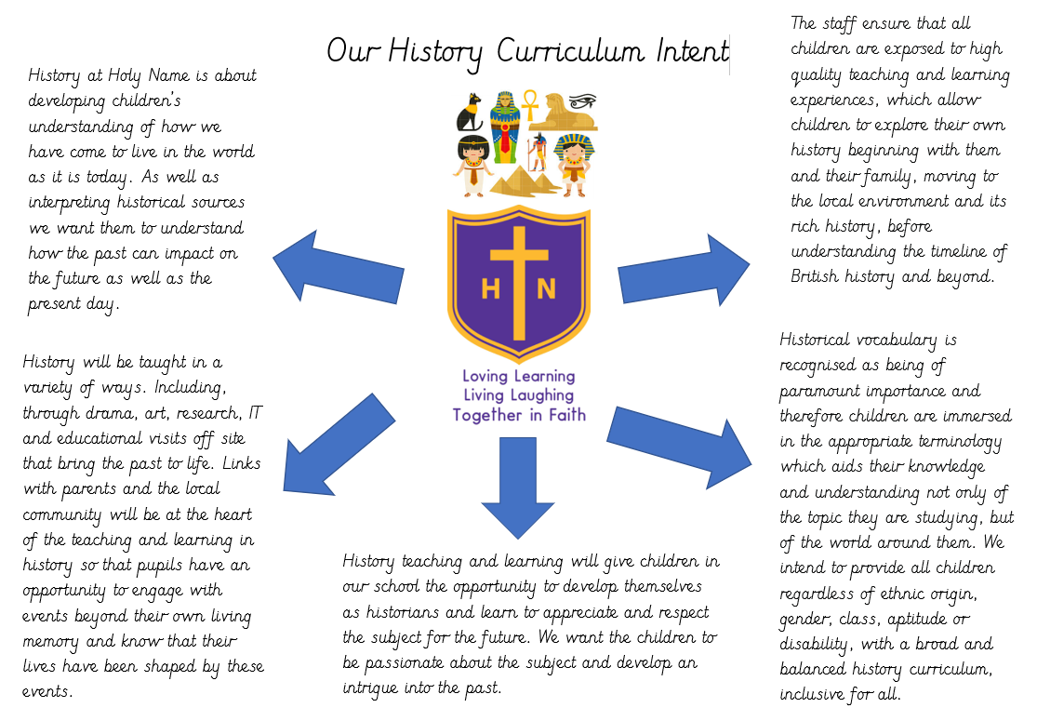

Slide 8
Rationale behind the history curriculum at Holy Name.
What is the rationale?
Our rationale is to continue to build a knowledge rich curriculum as defined by the terms in our overall curriculum rationale.
We think it is imperative that our younger children understand their own history and make links with their own past in the world around them so that they are then able to learn more about the wider history of the world, expanding their experiences of the world and therefore their vocabulary.
The Leeds locality is steeped in a rich history which is why we have begun to use a ‘Place Based Curriculum’. The children can further their understanding of the past by making links to places in their locality, helping them to know more and remember more about British history and the history of other places which contrast with this history.
How does it reflect the school context and the specific needs of the pupils?
Our children are already inquisitive about the past and like to ask lots of questions. They come from a variety of backgrounds and different heritages including; Poland, Ireland, Spain and the Middle East. Their locality is what unites them. Our children have a thirst for knowledge and are keen to learn more about their families and the world around them, including British history. They are not held back, but encouraged to celebrate their unique heritage and respect one and others’ differences.

Slide 9
School Aims and Values
Mission Statement
Loving, learning, living, laughing, together in faith.
How does the history curriculum reflect the schools aims and values / mission statement? If history is mentioned explicitly then how is this reflected in policy and day-to-day practice?
High quality inclusive education for all.
Provide subjects rooted in knowledge and skills. (chronological order, links to local history and diversity)
Children have a positive and committed attitude to learning.
Children develop knowledge and skills for their future.
Are all relevant staff and governors aware of the rationale and aims of the history curriculum?
Subject reports set out by leaders
Long term plan given to staff and on website
Curriculum rationale statement on website.
Book looks and learning walks

Slide 10
Long and Medium Term Plans
Do long term and medium term plans show clear progression in the sequencing of history skills and subject knowledge?
Long term plan, written by Holy Name and St Mary’s, shows a clear progression in the sequencing of historical skills and subject knowledge.
KS1 – focus on local area and significant figures.
KS2 – Chronological order to allow children to see the impact of History
The history LTP clearly breaks down the NC programmes of study into Key stages and then into specific year groups to show the progression of skills.
Each topic has an enquiry based question and individual Knowledge Organisers for each topic ensures the curriculum is covered and the skills/knowledge taught is progressive.
Is progression clearly based on the NC programmes of study for each Key Stage, but also broken down into year group progression?
Yes – see long term plan

Slide 11
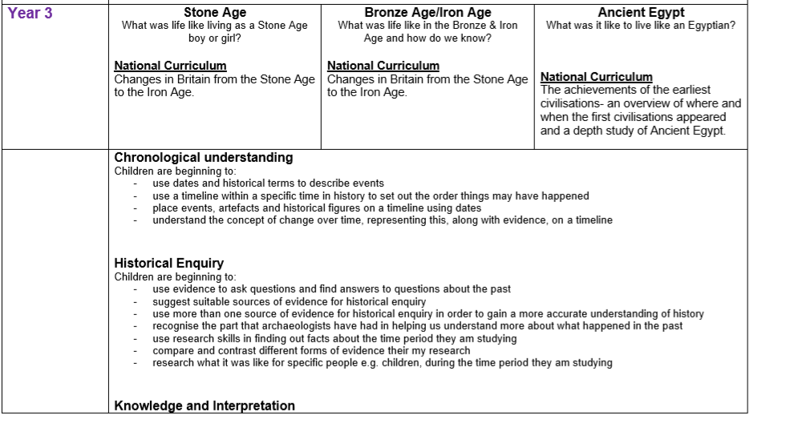
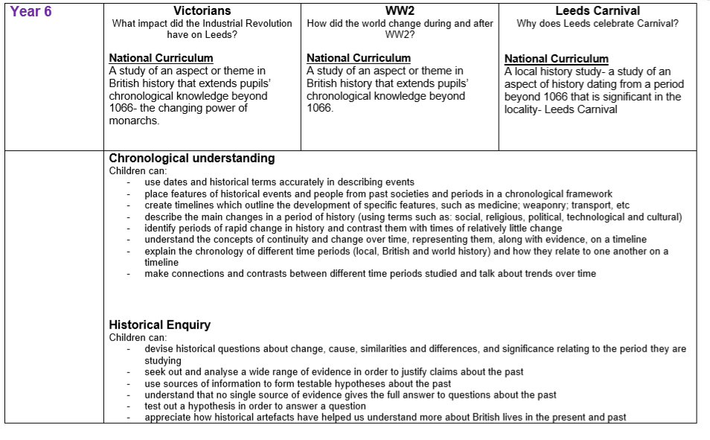

Slide 12
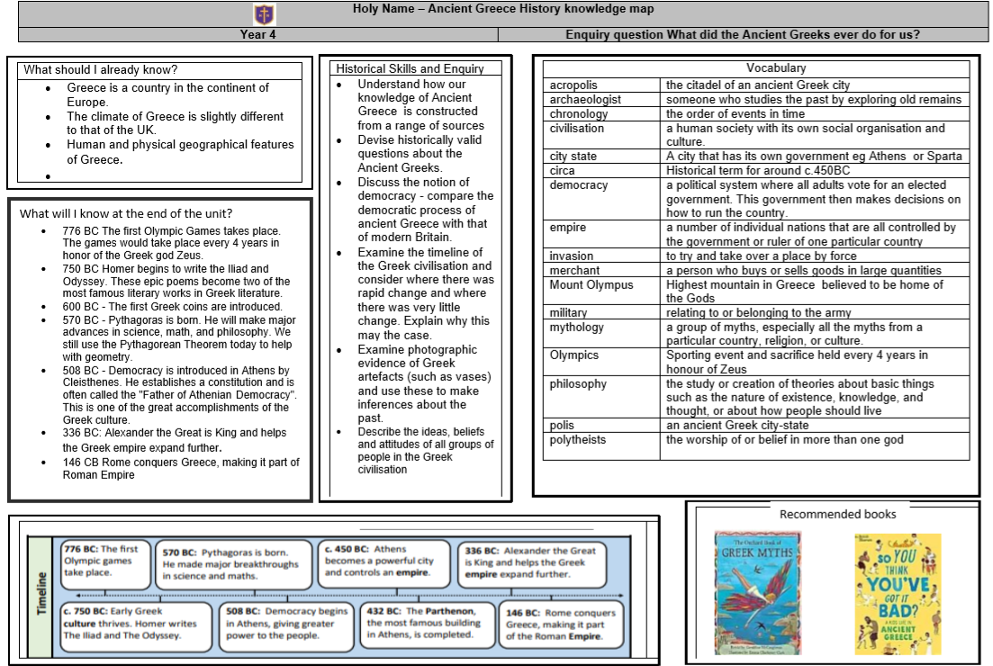
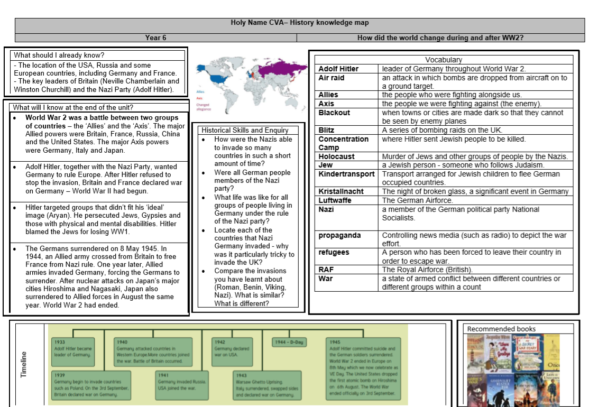
Knowledge Organiser

Slide 13
Our History Curriculum
How has the curriculum been adapted to enable all pupils to access content and make progress, according to need and starting point?
All children access the history curriculum. Teachers ensure that activities are differentiated or supported when needed to allow all children to meet the LO.
How does the school ensure pupils can at least meet end of key stage requirements in history?
Clear progression of skills, using the school’s LTP, which has clear objectives to follow.

Slide 14
Our History Curriculum
How does the school’s history curriculum reflect the Aims of the NC programme of study?
What opportunities are there for pupils to develop their reading skills in history?
Research opportunities – using internet
Books
Links to English topics- cross curricular writing Y5- Beowulf
Extended reading and writing opportunities

Slide 15
Skills and Knowledge
What opportunities are there for pupils to develop their history skills and knowledge across the curriculum?
Comparing and contrasting the local area (Geography)
Extended writing opportunities linked to Philip Webb
Art
Music

Slide 16
Implementation of the History Curriculum

Slide 17
Subject Leadership
Are you clear about your roles and responsibilities as history subject leader?
Ensure that history is being taught in line with the long term plan and national curriculum objectives.
Ensure that there is clear progression in history
Monitor the standards and quality of teaching
Up skill staff and provide/signpost staff to necessary resources to support learning.
Do you have sufficient subject knowledge and expertise to lead history and ensure the curriculum is fit for purpose?
CPD undertaken
History subject leaders training
National College subject leadership training

Slide 18
Curriculum Outcomes
How do you inform senior leaders and governors about the curriculum and outcomes in history, so they can quality assure your work?
SLT have looked at and scrutinised the long-term plans
Moderation from St Marys twice over the year
Leader to share Intent PowerPoint with staff and governors.
Action plan RAG rated and checked throughout the year
Pre and post assessments used from September 2020 alongside o track summative scores 3 X a year.
O track is now being used for all 3 assessment points.

Slide 19
Professional Development
How do you evaluate the professional development needs of your colleagues and then provide support and training?
Yorkshire Primary History network training meetings
National college CPD
Joint planning sessions with SM on a half termly basis to ensure consistency and to share ideas.
Staff questionnaires highlight areas where support is required.
A detailed long-term plan supports staff with planning
Book look feedback and discussions

Slide 20
History Across School
When and how have you developed best practice in history across the school?
Clear progressive LTP document to support teachers with planning
Staff meetings
Provide updated classroom resources (links to online resources and planning ideas)
Demonstrate good practice in own teaching- sharing ideas

Slide 21
History Across School
Is the history curriculum effectively resourced?
Topic boxes
Access to digimaps for Geo links to History topics
Funding for certain field trips
2021 new books ordered across school
2022 new resources ordered for all key stages which are being used consistently.

Slide 22
History Across School
How do teachers adapt long term and medium term planning to meet the needs of specific classes, groups and individuals?
How is curriculum delivery equitable for all groups and appropriate?
Do any pupils regularly miss history lessons because of absence issues?
Clear progressive LTP document to support teachers with planning
Pre and post assessment allow teachers to find gap and plan accordingly
Staff meetings providing CPD
Provide updated classroom Demonstrate good practice in own teaching- class assembly to show examples of cross curricular links
Intervention timetable adapted so that children do not miss out. (change the timing of lessons each week)

Slide 23
History Across School
Is history knowledge taught to an appropriate depth and with clear and necessarily detailed progression through each year group?
Long term plans show clear detail and progress.

Slide 24
Assessment and Monitoring
Are effective assessment arrangements in place for history?
- Pre and Post assessments are in place
How are standards in history moderated to ensure assessments are accurate?
- Pre and post assessments have been designed with our partner school to ensure consistency. Questions have been taken from the national curriculum objectives.
How does the history leader know that the planned curriculum is taught in each class?
Book scrutinies are carried out by the history lead.
Displays updated and photos taken
Displays are used as working walls with relevant reading books.

Slide 25
Impact of the history Curriculum

Slide 26
End of Key Stage Expectations
How can the school demonstrate that pupils reach end of key stage expectations in history?
Book scrutiny
Learning walks
Pre and post assessment sheets to show progression in topics
O track summative assessments 3 X year

Slide 27
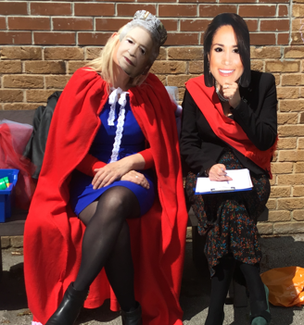
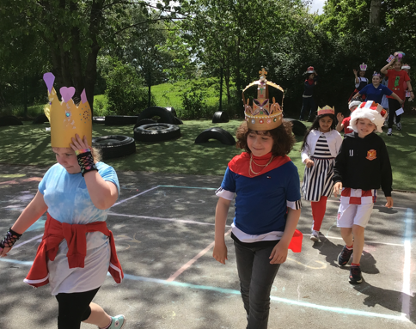
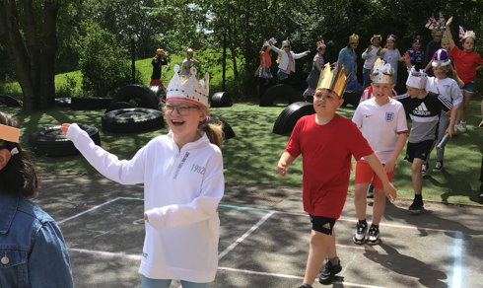
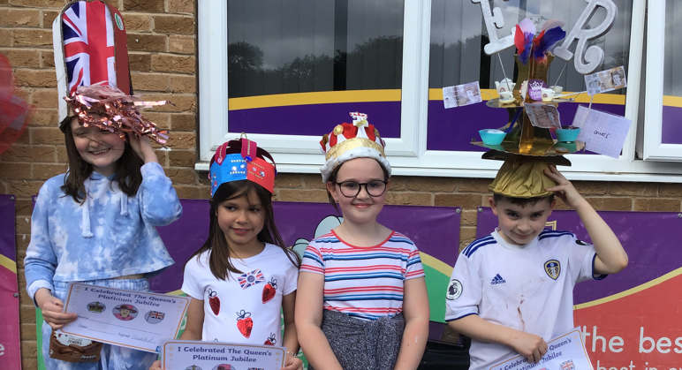
Jubilee Celebrations

Slide 28
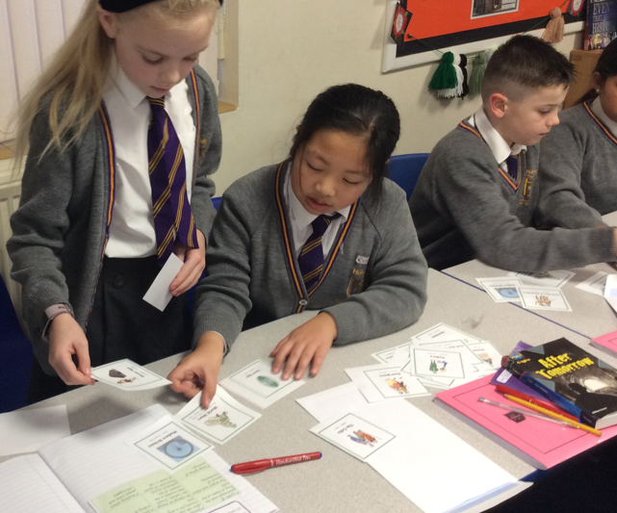
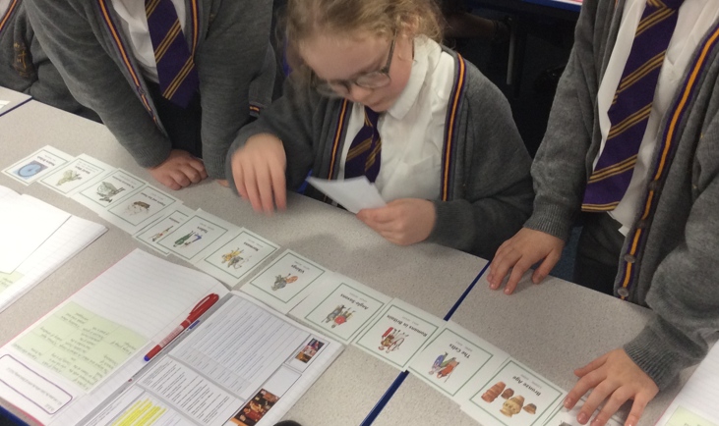
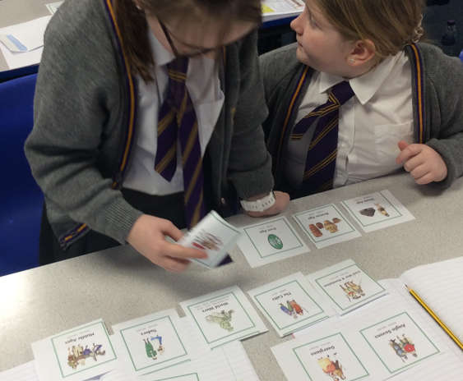
All classes should begin their history topic with a timeline activity.

Slide 29
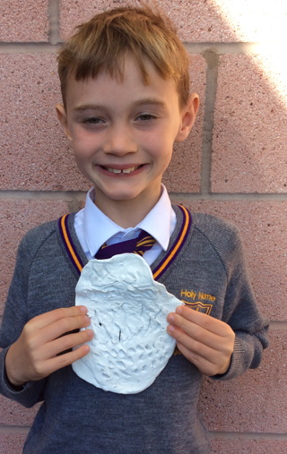
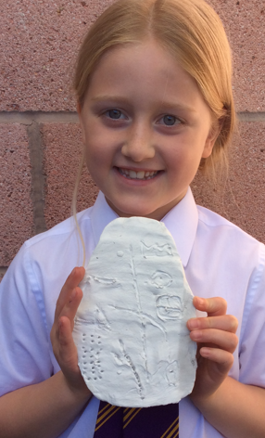
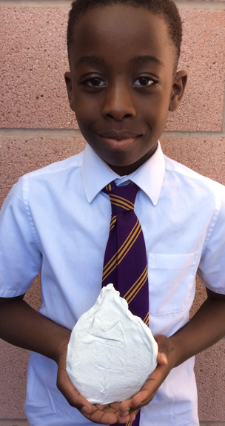
Dragon Bones

Slide 30
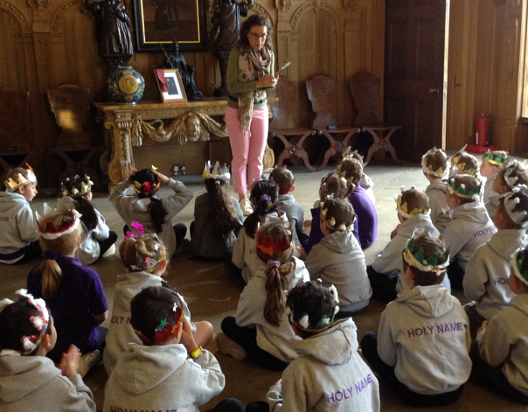
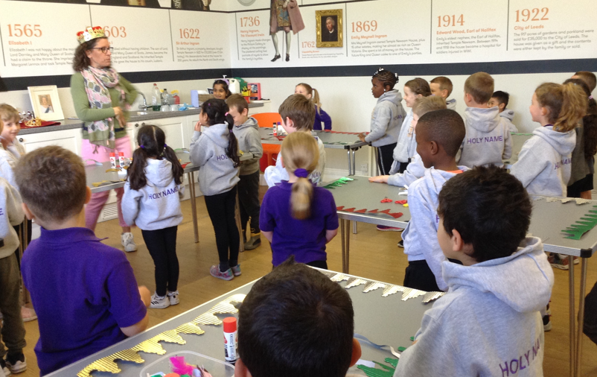
Kings and Queens

Slide 31
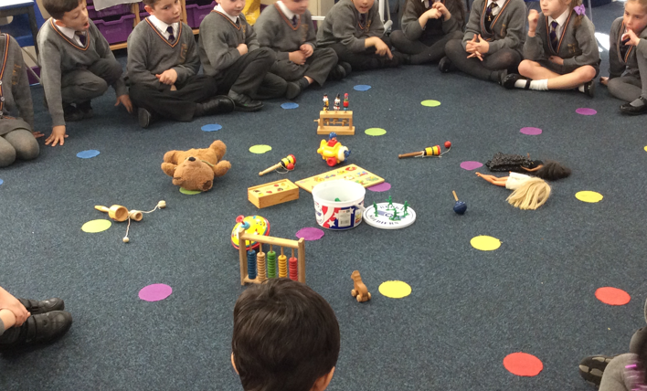
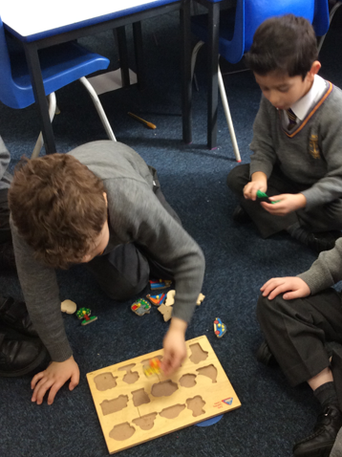
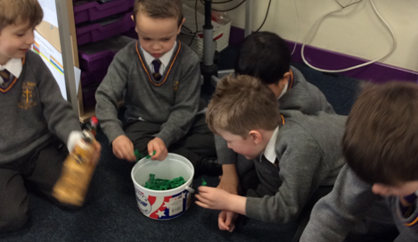
Toys

Slide 32
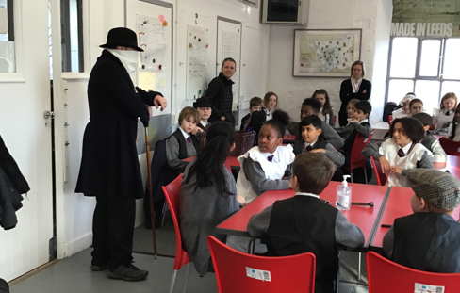
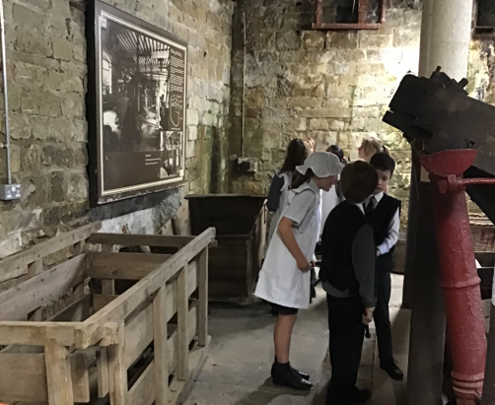
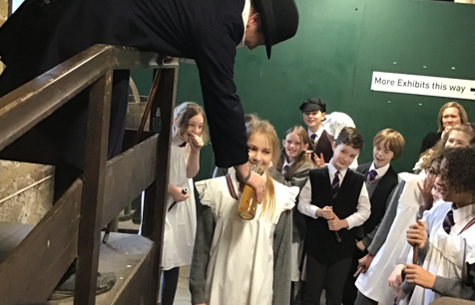

Slide 33
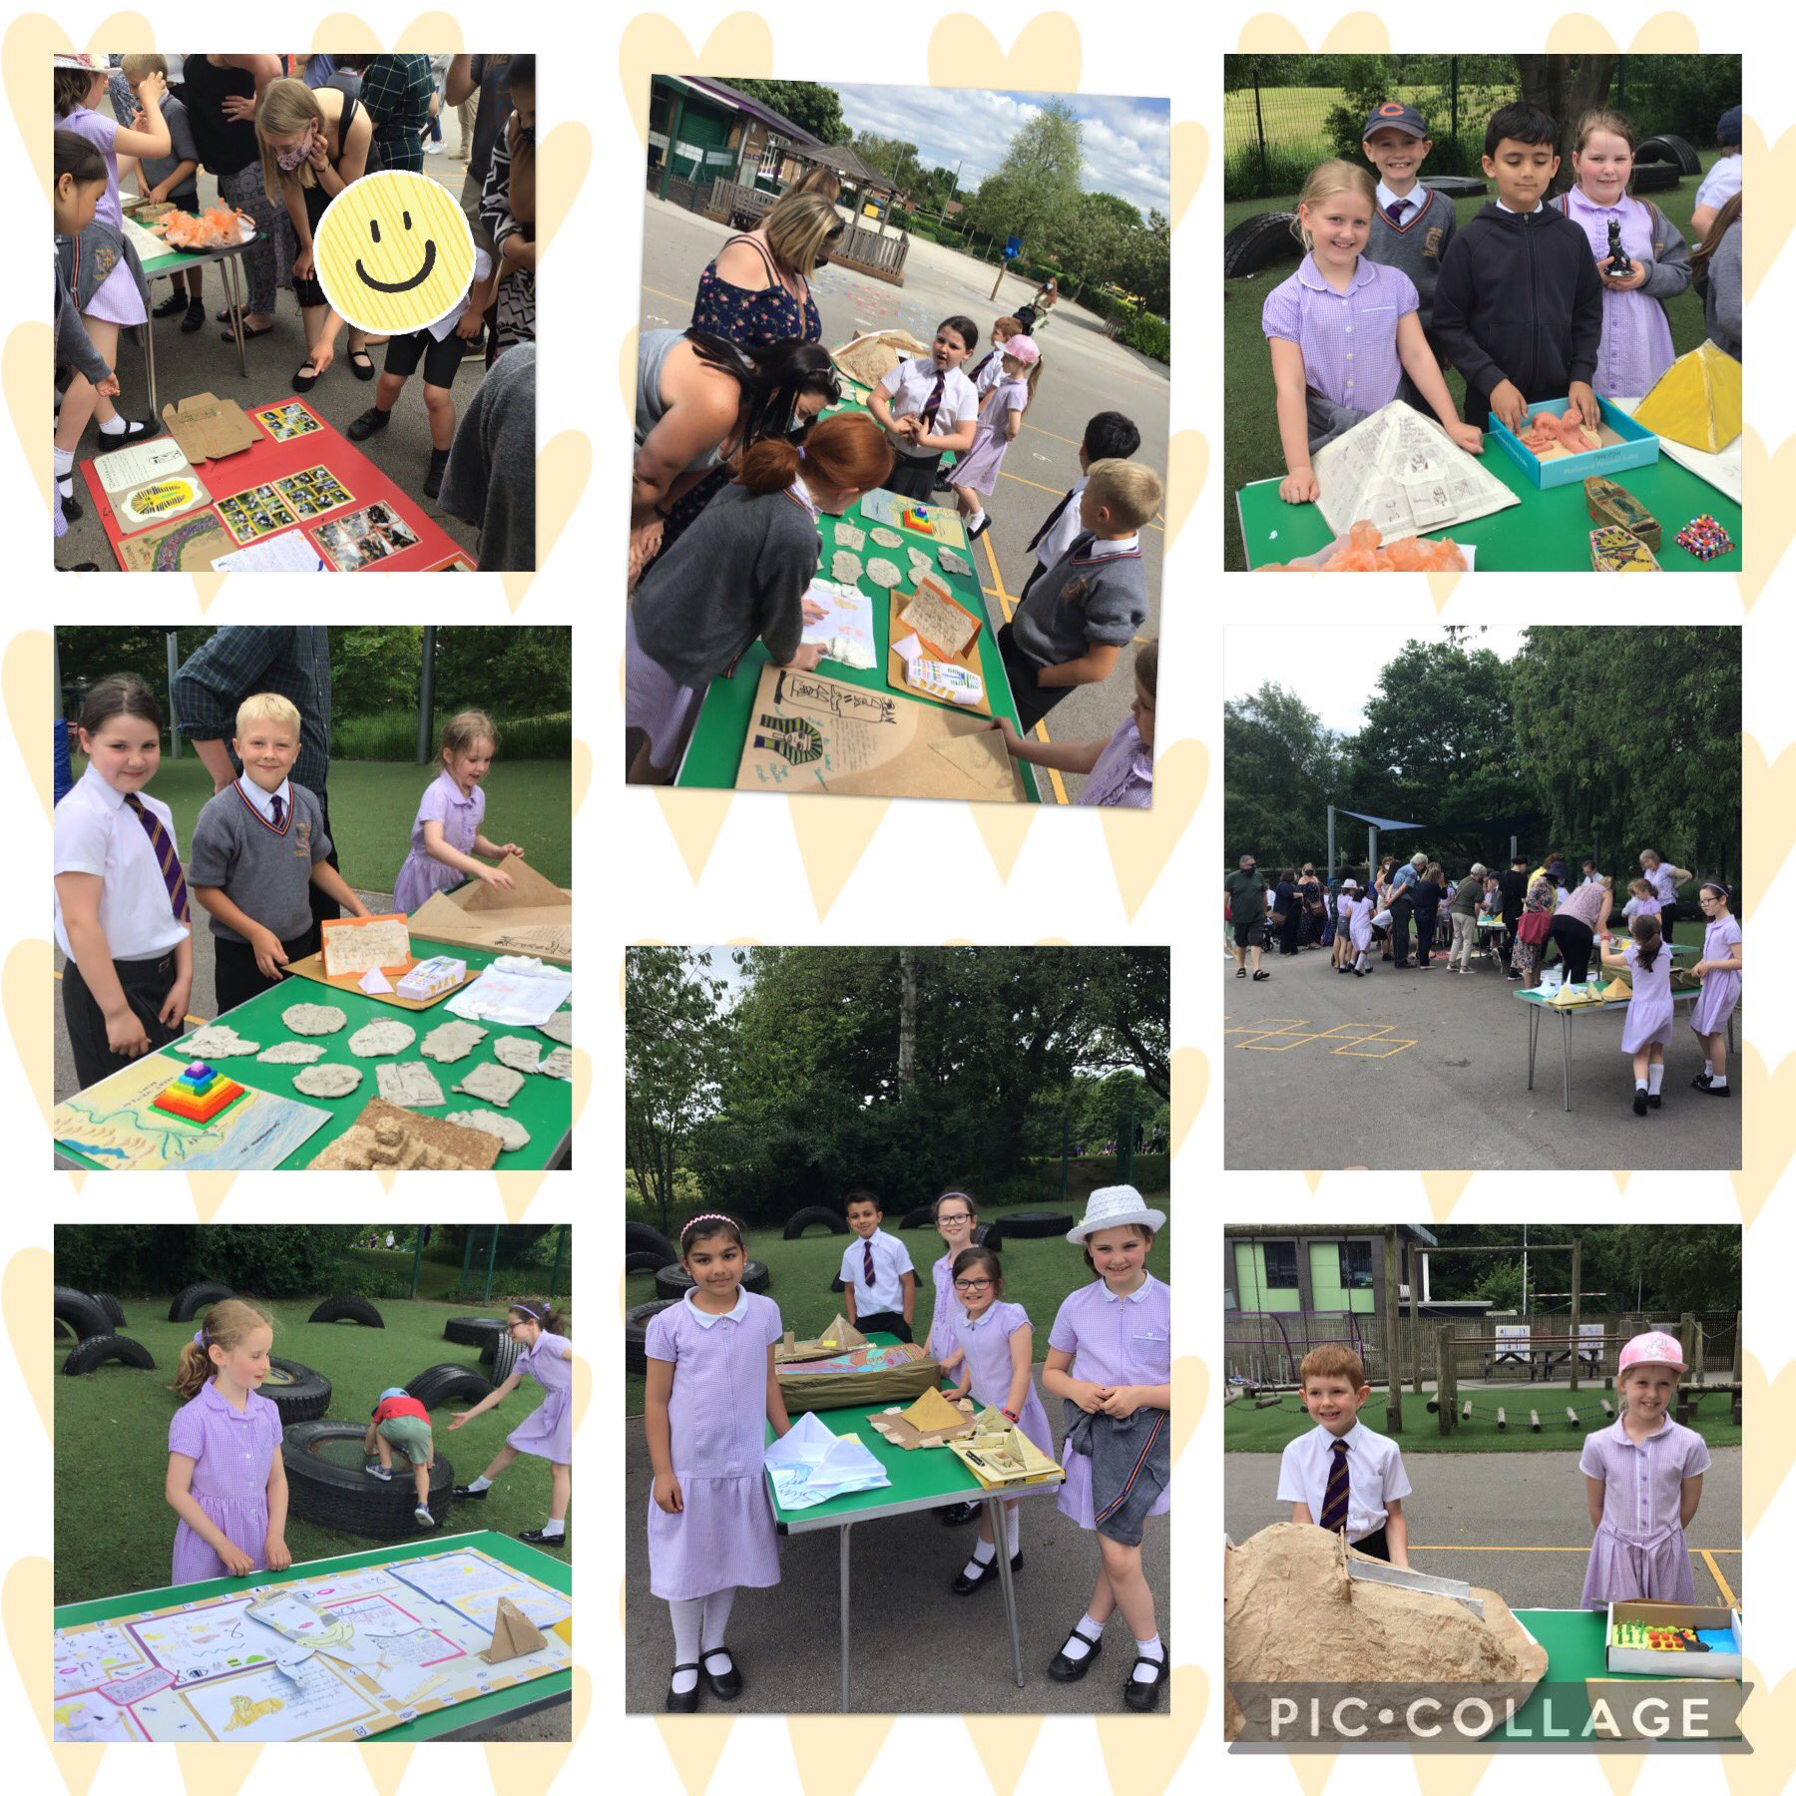
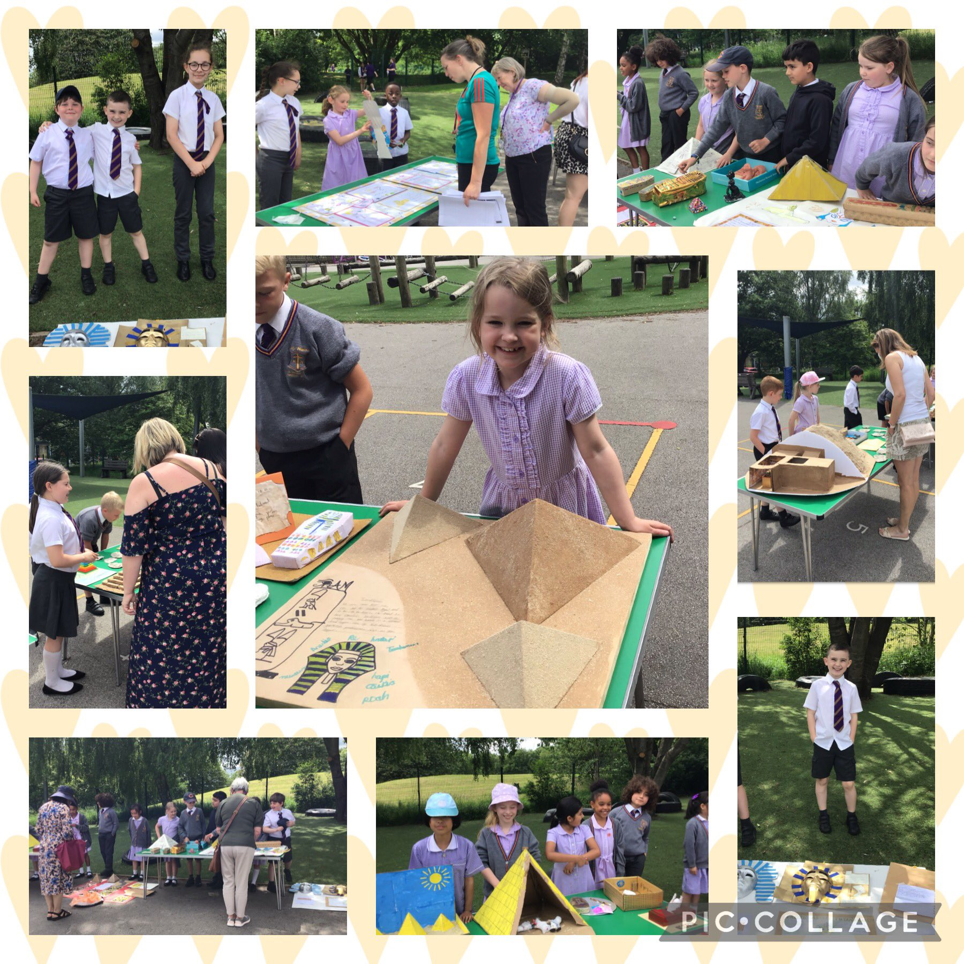
Egyptian Museum

Slide 34
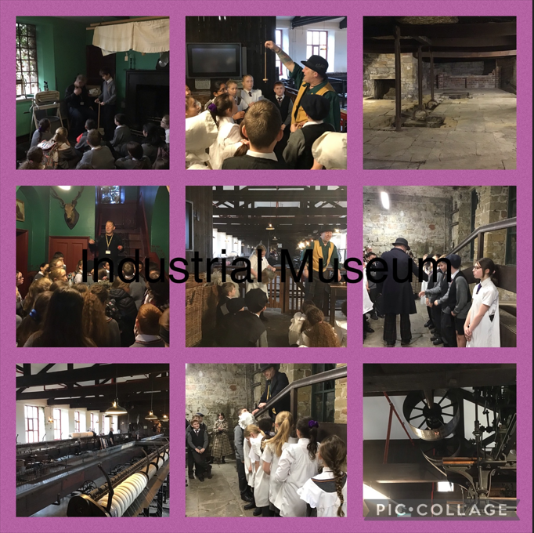
Leeds Industrial Museum Y6 2022

Slide 35
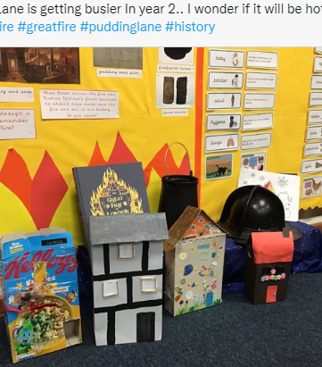
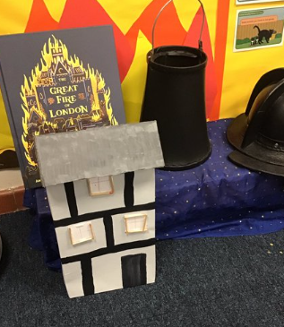
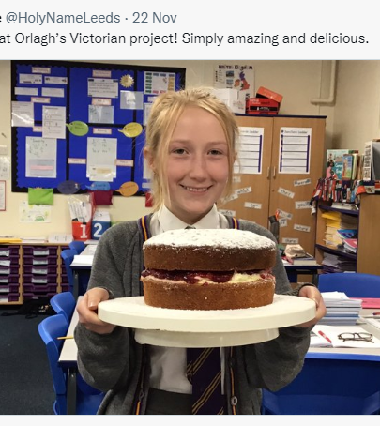
Homework projects

Slide 36
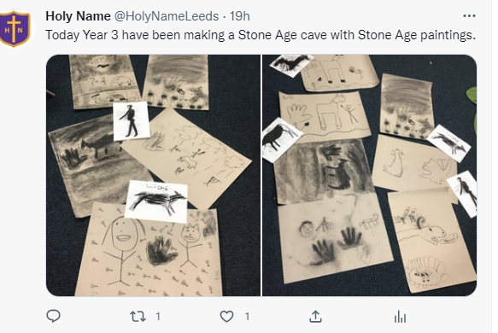
Cross-curricular History

Slide 37
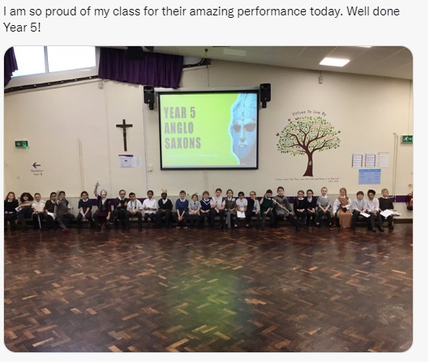
Assemblies

Slide 38
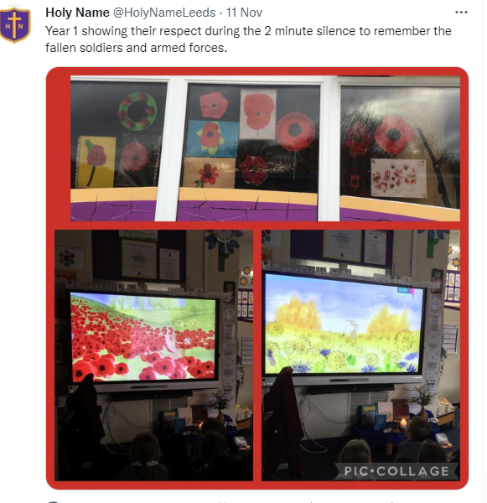
Remembrance

Slide 39
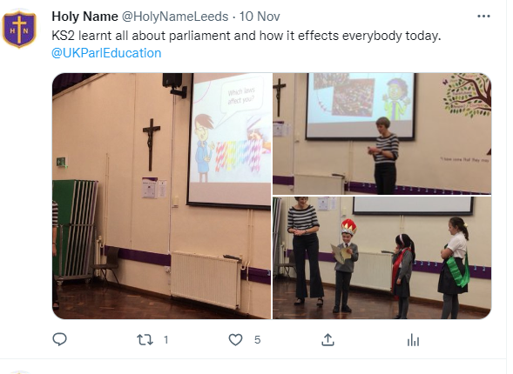
Parliament workshop

Slide 40
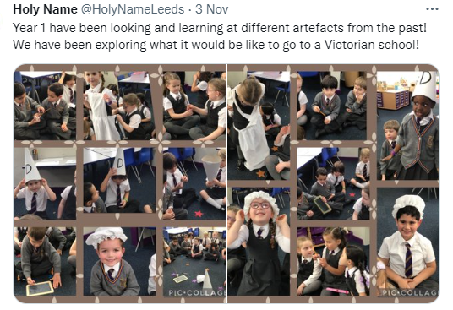
Victorian schooling

